Slide 1

Java III

Slide 2

Hibernate
Object-Relational Mapping

Slide 3
Hibernate:
Introduction

Slide 4



Hibernate: Introduction*
• Hibernate is a free tool used in Java
programming that allows data to be
inserted, removed or changed in a
database without paying a lot of
attention to how it gets there. So
SQL is used—Hibernate does that.
• Hibernate was founded by Mr.
Gavin King, an Australian developer who needed to solve a problem and ended up creating Hibernate, an open source tool that is amazingly useful.
Gavin King

Slide 5

Hibernate: Introduction*
• The central idea of Hibernate is this: Java programmers are used to creating POJOs [Plain Old Java Objects] in Java. So why do they need a second language—SQL—to put or persist those POJOs into the database?
• Hibernate does object-relational persistence and querying.
• That means Hibernate puts whole objects into a relational database and pulls whole objects out of a relational database.
• Or—that’s what it appears to do. For the most part, that’s all a Java programmer needs to know.
Grateful thanks to Mr. Kosta Kontos of Kontos Tehcnologies for technical assistance in the making of this lecture.

Slide 6
Hibernate:
When Can I Use Hibernate?

Slide 7
Hibernate: When Can I Use Hibernate?
• Hibernate can be used in any Java program that needs to access a relational database.
• Hibernate does not need an application server to run in.
• Hibernate can be used in any Java class with really no other dependencies other than on a single Hibernate JAR file and one configuration file.

Slide 8
Hibernate:
When Should I Use Hibernate?

Slide 9


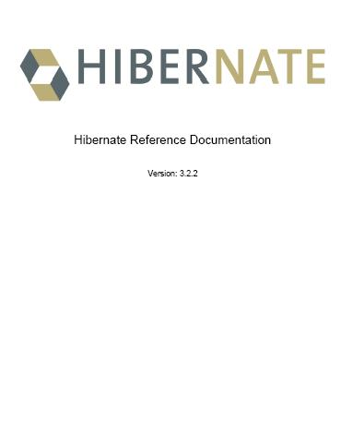
Hibernate: When Should I Use Hibernate?
• According to The Man himself [Gavin King], you should only consider using Hibernate if:
→ You have a non-trivial application
→ You have more than 10 tables in your relational DB.
→ Your application uses an object-oriented Domain Model.
What is a Domain Model?
“An application with a Domain Model doesn’t work directly
with the tabular representation of the business entities; the
application has its own, object-oriented model of the business
entities. If the database has ITEM and BID tables, the Java
application defines Item and Bid classes.”¹
1Page 6, “Hibernate In Action” by Christian Bauer and Gavin King (A book you should buy)

Slide 10
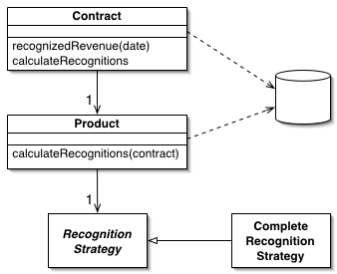

Sidebar: What is a Domain Model?
“Domain Model—An object model of the domain that incorporates both behavior and data.”¹
• When you implement a Domain Model, that means you’re trying to create objects [Java Classes] that model the business area you’re working in.
• In other words, when you build your objects as a Domain Model, your goal is to match the business as closely as possible.
• A Domain Model is geared towards mimicking the way the data lives in the business.
• So, in the diagram (above), we see that our POJO for Contract contains the methods (behaviors) that work on a contract. The Product POJO is geared to everything to do with a product. Notice how these POJOs interact and have a composition (“has a”) relationship.
• “A Domain Model should use fine-grained objects with fine-grained interfaces.”²
¹ Patterns of Enterprise Application Architecture by Martin Fowler, Addison-Wesley, 2003 (front cover)
² Fowler, page 118
Domain Model example from Martin Fowler's website

Slide 11
Hibernate: When Should I Use Hibernate?
• If your application does a lot of business logic—and does much more than just display tables of data on a webpage—then it is a good candidate for Hibernate.
• Hibernate is best in applications with complex data models, with hundreds of tables and complex inter-relationships.
• In a normal JDBC application, you deal with populating a List of POJOs with data you manually pulled from a ResultSet.

Slide 12
Hibernate:
How Hibernate Works

Slide 13
Hibernate: How Hibernate Works
• Hibernate does not force you to change your POJOs.
• Hibernate does not force you to implement any interface.
• Hibernate works on any POJO.
• Hibernate requires 1 overall configuration file.
• That 1 configuration file tells Hibernate
→ Which classes you want to store in the database.
• Each mapped class needs an additional configuration file.
→ How each class relates to the tables and columns
in the database.

Slide 14
Hibernate: How Hibernate Works
• Hibernate expects your Hibernate class to:
→ Have at least a no-argument constructor.
• Just as your database Table has a primary key that uniquely identifies each row, your Hibernated class will have an identifier instance variable that uniquely identifies that instance.
• The type of your identifier can be
→ a primitive [ int, long, etc ] (not recommended)
→ a type-wrapper class [Integer, Long, etc]
→ even a String (not recommended)

Slide 15
Hibernate: How Hibernate Works
• Hibernate stores the data from One Instance of your class in One Row in your table.
One Instance of Class = One Row in a Table
• Hibernate handles getting the data from your class to the table and from the table into your class.
• If your object has a relationship with other objects, Hibernate is able to get that data too and give you your objects populated and associated.

Slide 16
Hibernate:
Our First Example

Slide 17
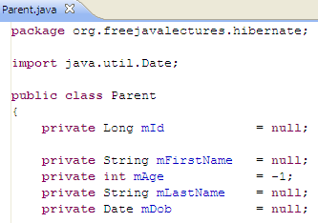
Hibernate: Our First Example
• We have an object called Parent.java. It contains five instance variables. We would like to insert the data in this class in the database.
You should notice that this is just a POJO. We are planning to set these variables with some values and then asking Hibernate to put these values into a single row in the DB.
The id value is important. This will be used to uniquely identify this particular object’s row in the DB.

Slide 18
Hibernate: Our First Example
• Hibernate will decide on its own whether or not two objects represent the same row in the database.
• How does Hibernate do that?
• Think about it. If I asked you: “Does this object have the same values as a row in the database?”
• What is the best way to answer that?
• Well, if the Primary Key of a table row is equal to the values for the Primary Key fields in a Java Object, then we would be pretty safe in assuming the object contains the data from the row.

Slide 19
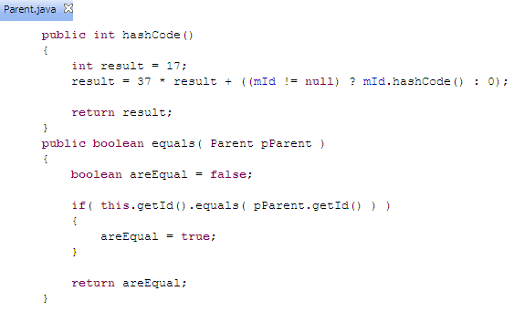
Hibernate: Our First Example
• That’s precisely how Hibernate does it.
• Hibernate uses two special methods that you must* write for any class that you want Hibernate to manage.
• Hibernate needs those methods to decide if row = object
The hashCode() method trusts you to have a primary key that uniquely identifies each instance of your class. So, whatever it takes to show that this instance is unique—should be part of your primary key and part of your hashCode() method.
*You only need a hashCode() and equals() method in your class if you:
Intend to put instances of your persistent class into a Set and if you expect to use something called “reattachment of detached instances”—which means pull persisted copies back for use again without going to the DB.
My rule? If it has an hbm.xml file, you need these.

Slide 20
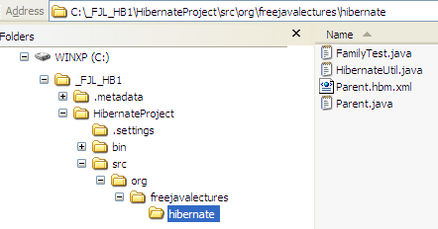
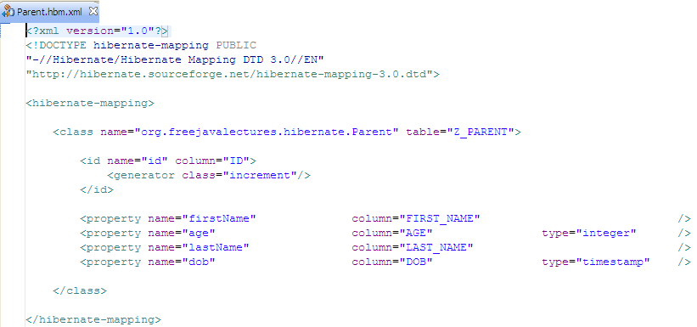
Hibernate: Our First Example
• Below is the all-important Hibernate mapping file.
• By convention it is named after the class it is paired with.
• It is also stored in the same
directory as the class.

Slide 21
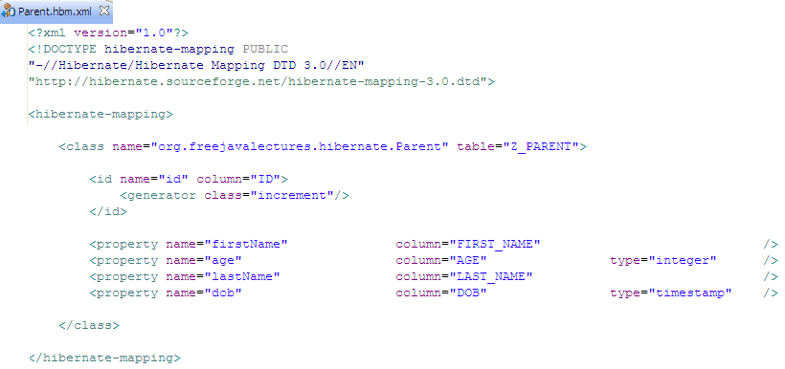
Hibernate: Our First Example
• We see, first of all, that it creates an association between our Parent.java class and the table Z_PARENT.
Here, we see how it connects the class ‘Parent.java’ with the table Z_PARENT
Hibernate will take care of populating the ID field. In this example, we’re telling Hibernate how to decide the next value to insert in this field. We’re saying: “increment” the previous value.
Next, we are creating an association between the id field in our class (accessed by executing the method getId() of class Parent.java.) This means that each row in the table Z_PARENT will hold the data for one instance of this class.

Slide 22
Hibernate: Our First Example
• This file maps five instance variables within the Parent.java class to five columns in the table Z_PARENT.

Slide 23
Hibernate: Our First Example
• Finally, we notice that one of the properties is called dob and it maps to the column DOB. Notice the type attribute. In this case, we see type=“timestamp”. Well, that “timestamp” is not a Java type. Nor is it an SQL type. Instead, it’s a Hibernate specific type.
This is the dob POJO value that is mapped using a Hibernate timestamp type to a DB column of type DOB

Slide 24
Hibernate: Our First Example
• Okay, so far we have set up a class—Parent.java—with three instance variables.
• We also have a DB table—Z_PARENT—with columns such that each row in the table can store the values from one instance of our class Parent.java.
• And we also have a Hibernate mapping file—Parent.hbm.xml—that will allow us to move that data from the class to the table without writing any SQL.

Slide 25
Hibernate: Our First Example
• Finally, although I haven’t mentioned it yet, there is a single global configuration file for Hibernate called hibernate.cfg.xml.
• This file describes how Hibernate will connect to the database and it also includes a list of all the xxx.hbm.xml files.

Slide 26
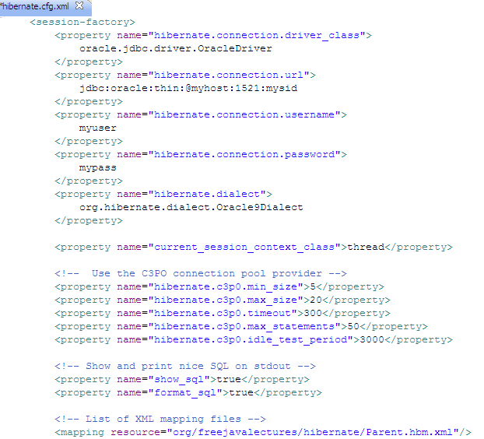
DB Driver. Must be on classpath
DB URL—specific to each DB.
Username and password.
For testing you want this ‘true’ so you can see the queries Hibernate is creating.
Notice that we need to register our hbm.xml file.

Slide 27
Hibernate: Our First Example
• Next question? How do we make that magic happen?
• How do we execute all this stuff?

Slide 28
Hibernate:
Executing The Example

Slide 29
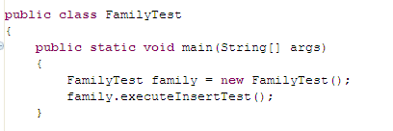
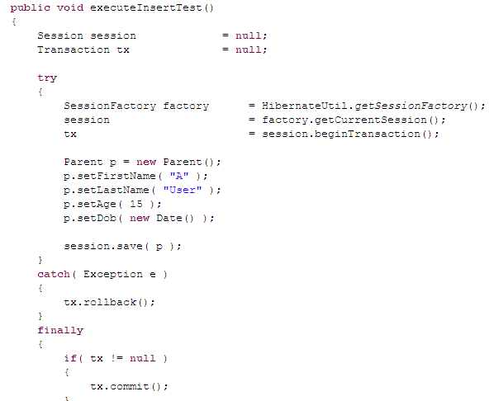
Hibernate: Executing The Example
• This is a Java application that will execute our example.
The purpose of this main method is just to execute the method executeInsertTest().
Hibernate does not notice our code unless we are executing under something called a Hibernate session. As you see here, we get the current Hibernate session and then we begin a transaction.

Slide 30
Hibernate: Executing The Example
• Notice that we are in a Hibernate session, we save() the object and then commit the transaction.
This is kind of strange. We did not do much at all. Just asked Hibernate to save our object. I wonder what happened because of that. Let’s go see.
The insert is not actually executed until the tx.commit();

Slide 31
Hibernate: Executing The Example
• First of all, here is the SQL that Hibernate generated as a result of our Save request:
This is very strange. Why do you think Hibernate did that ‘select max(ID) from Z_PARENT’?
Answer: we told Hibernate that we wanted it to handle setting the primary keys. So, it is first finding out the highest number and then it uses that value for the insert. All just by saying “Save”. Pretty cool, huh?
Hibernate:
select
max(ID)
from
Z_PARENT
Hibernate:
insert
into
Z_PARENT
(FIRST_NAME, AGE, LAST_NAME, DOB, ID)
values
(?, ?, ?, ?, ?)

Slide 32
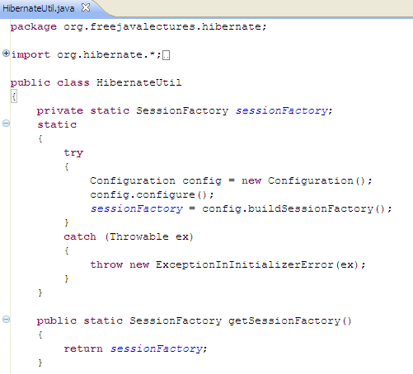
Hibernate: Executing The Example
• For the sake of completeness, I’m going to also include the HibernateUtil class.

Slide 33
Hibernate: Executing The Example
• In the preceding example, I inserted the object into the DB using session.save(). In the Hibernate world, there are usually many alternative ways to do the same thing. Keep that in mind.

Slide 34
Hibernate:
Reading The Data We Just Inserted

Slide 35
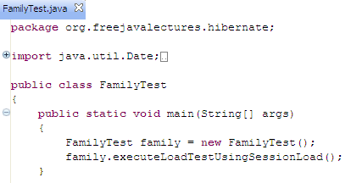
Hibernate: Reading The Data We Just Inserted
• Okay, so we inserted a row in the database.
• Now, we want to read that data.
We have a method that uses something called “session.load()” to read our data.

Slide 36
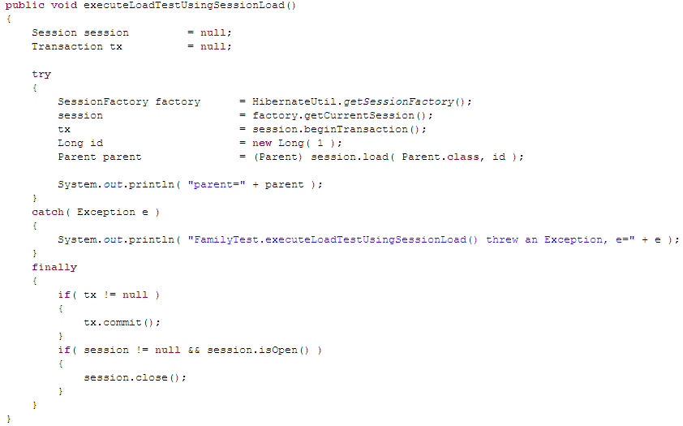
Hibernate: Reading The Data We Just Inserted
• This is the method that loads the data.
• Notice the session.load()
We want to pull up the row from the DB that has a primary key (the identifier) equal to 1.
Then, we ask Hibernate to return us an object that is populated with the data from the row in Z_PARENT whose primary key = 1.

Slide 37
Hibernate: Reading The Data We Just Inserted
• This is the SQL that Hibernate generated based on our session.load() request.
Hibernate:
select
parent0_.ID as ID0_0_,
parent0_.FIRST_NAME as FIRST2_0_0_,
parent0_.AGE as AGE0_0_,
parent0_.LAST_NAME as LAST4_0_0_,
parent0_.DOB as DOB0_0_
from
Z_PARENT parent0_
where
parent0_.ID=?

Slide 38
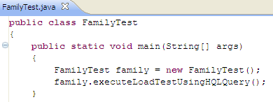
Hibernate: Reading The Data We Just Inserted
• Now, as promised, let’s try an alternate way to load that object.
This example uses something called an HQL query—which is a SQL variant called Hibernate Query Language.

Slide 39
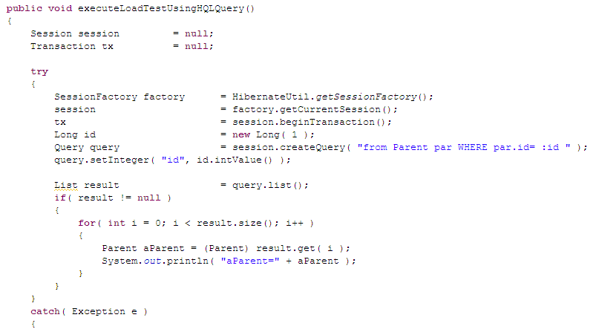
Hibernate: Reading The Data We Just Inserted
• Here is the meat of the code. It remains the same as the previous version with the exception of one section.

Slide 40
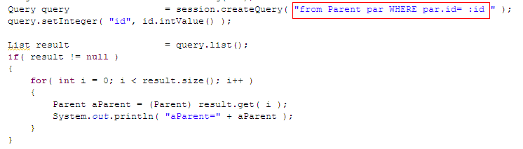
Hibernate: Reading The Data We Just Inserted
• Notice the syntax of an HQL query. It relies on Hibernate to find the getters and setters in the same way that Java Reflection does.
By convention, an HQL query returns an object that implements the java.util.List interface. [The exact implementation is probably not an ArrayList, by the way.]
After the List is returned to us, we look through it for instances of our target Parent class.

Slide 41
Hibernate: Reading The Data We Just Inserted
• Finally, let’s look at the SQL that Hibernate generated based on our HQL Query. You should notice that it’s exactly the same as the one based on our session.load().
Hibernate:
select
parent0_.ID as ID0_,
parent0_.FIRST_NAME as FIRST2_0_,
parent0_.AGE as AGE0_,
parent0_.LAST_NAME as LAST4_0_,
parent0_.DOB as DOB0_
from
Z_PARENT parent0_
where
parent0_.ID=?

Slide 42
Hibernate:
Review So Far

Slide 43
Hibernate: Review So Far
• The example we have covered so far is pretty simple. It writes to a single table and reads from a single table.
• What other complications could we encounter?
→ One Table—already covered.
→ Two Tables linked by a foreign key
→ Two Tables using an Association Table
only the keys in Association Table.
→ Two Tables linked by an Association Table
with extra non-key attributes on the
Association Table.
→ Join on Several Tables.

Slide 44
Hibernate:
Two Tables Linked By a Foreign Key

Slide 45
Hibernate: Two Tables Linked By a Foreign Key
• So, let’s take this gently.
• We will examine tables, classes and .hbm.xml files.
• First, let’s look at the two tables we will be linking.
• The tables are joined by a simple primary key.
• This is a 0:M relationship.
CREATE TABLE Z_PARENT
(
ID NUMBER NOT NULL,
FIRST_NAME VARCHAR2(20 BYTE),
AGE NUMBER,
LAST_NAME VARCHAR2(20 BYTE),
DOB DATE
)
0:M
CREATE TABLE Z_CHILD
(
ID NUMBER NOT NULL,
PARENT_ID NUMBER,
FIRST_NAME VARCHAR2(50 BYTE),
LAST_NAME VARCHAR2(50 BYTE),
DOB DATE,
AGE NUMBER
)

Slide 46
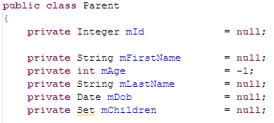
Hibernate: Two Tables Linked By a Foreign Key
• We will change our Parent class to include an instance variable called children.
So, we see that our Parent class has a 0:M relationship with out Child class. The mChildren instance variable will hold 0:M Child objects.

Slide 47
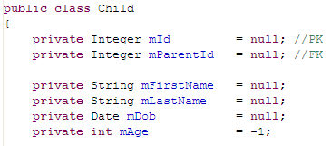
Hibernate: Two Tables Linked By a Foreign Key
• The Child class has a 0:M relationship with our
So, we see that we have a Child class that has a foreign key to the Parent class.

Slide 48
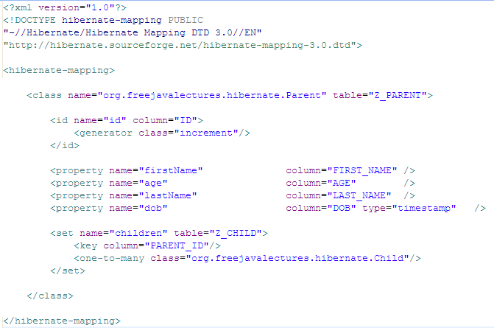
Hibernate: Two Tables Linked By a Foreign Key
• Mappings for those classes and their relationship.
Parent.hbm.xml
This is our mapping for the Parent class. The most important part is the set mapping.
The strangest part of this is how the foreign key field PARENT_ID is mentioned in the Parent.hbm.xml file—not in the Child.hbm.xml—as you might expect.
CREATE TABLE Z_PARENT
(
ID NUMBER NOT NULL,
FIRST_NAME VARCHAR2(20 BYTE),
AGE NUMBER,
LAST_NAME VARCHAR2(20 BYTE),
DOB DATE
)
CREATE TABLE Z_CHILD
(
ID NUMBER NOT NULL,
PARENT_ID NUMBER,
FIRST_NAME VARCHAR2(50 BYTE),
LAST_NAME VARCHAR2(50 BYTE),
DOB DATE,
AGE NUMBER
)

Slide 49
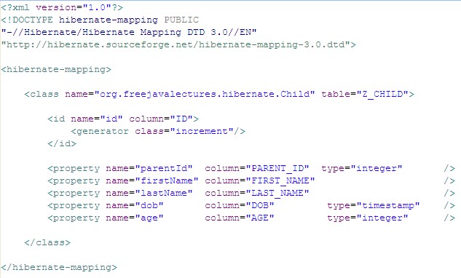
Hibernate: Two Tables Linked By a Foreign Key
• Mappings for those classes and their relationship.
Child.hbm.xml
This mapping just maps the fields in the Child class. Other than the presence of the parentId field, there is no code here regarding the 0:M relationship.
CREATE TABLE Z_CHILD
(
ID NUMBER NOT NULL,
PARENT_ID NUMBER,
FIRST_NAME VARCHAR2(50 BYTE),
LAST_NAME VARCHAR2(50 BYTE),
DOB DATE,
AGE NUMBER
)

Slide 50
Hibernate: Two Tables Linked By a Foreign Key
• When we execute a simple retrieval query, all we need to do is ask for Parent.
• Hibernate will see that a Parent has a relationship with many Child objects and it will give us a Parent object with its mChildren variable populated with a Set of Child objects.

Slide 51
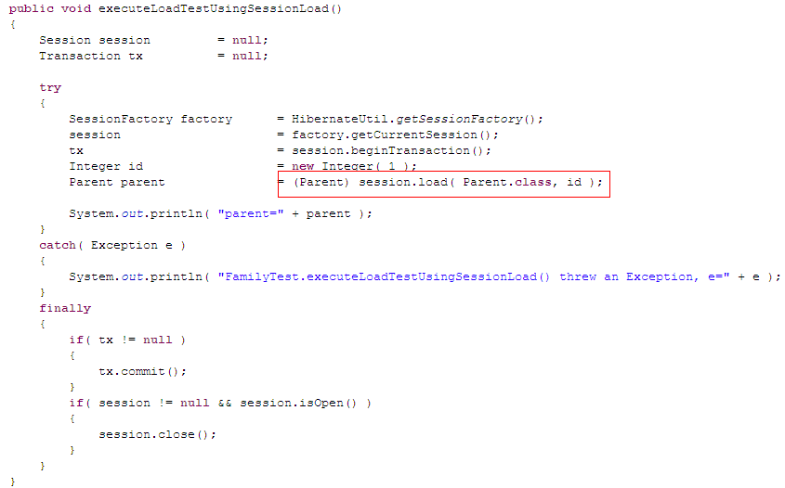
Hibernate: Two Tables Linked By a Foreign Key
• This should look familiar. No changes are needed from the earlier version of this.

Slide 52
Hibernate: Two Tables Linked By a Foreign Key
• What is most important is seeing the Queries that Hibernate generated as a result of our mapping.
Hibernate:
select
parent0_.ID as ID0_0_,
parent0_.FIRST_NAME as FIRST2_0_0_,
parent0_.AGE as AGE0_0_,
parent0_.LAST_NAME as LAST4_0_0_,
parent0_.DOB as DOB0_0_
from
Z_PARENT parent0_
where
parent0_.ID=?
Hibernate:
select
children0_.PARENT_ID as PARENT2_1_,
children0_.ID as ID1_,
children0_.ID as ID1_0_,
children0_.PARENT_ID as PARENT2_1_0_,
children0_.FIRST_NAME as FIRST3_1_0_,
children0_.LAST_NAME as LAST4_1_0_,
children0_.DOB as DOB1_0_,
children0_.AGE as AGE1_0_
from
Z_CHILD children0_
where
children0_.PARENT_ID=?
So we see that Hibernate first queried for the Parent and then it queried a second time for all the Child objects whose parentId = Parent.getId()

Slide 53
Hibernate: Two Tables Linked By a Foreign Key
• This is the result of my fancy toString().
parent=
--------------
Parent
--------------
mId =1
mFirstName =A
mAge =15
mLastName =User
mDob =2007-08-28 15:59:27.0
--------------
mChild =
------------------
Child
------------------
mId =3
mParentId =1
mFirstName =three
mLastName =child
mDob =1902-01-01 00:00:00.0
mAge =104
------------------
mChild =
------------------
Child
------------------
mId =1
mParentId =1
mFirstName =one
mLastName =child
mDob =1900-01-01 00:00:00.0
mAge =106
------------------
mChild =
------------------
Child
------------------
mId =2
mParentId =1
mFirstName =two
mLastName =child
mDob =1901-01-01 00:00:00.0
mAge =105
------------------
--------------
• We see that one instance of the Parent object is associated with three instances of the Child object.

Slide 54
Hibernate: Review So Far
• That covers Two Tables linked by a foreign key.
• What other complications could we encounter?
→ One Table—already covered.
→ Two Tables linked by a foreign key—already covered.
→ Two Tables using an Association Table only
the keys in Association Table.
→ Two Tables linked by an Association Table
with extra non-key attributes on the
Association Table.
→ Join on Several Tables.

Slide 55
Hibernate:
Two Tables using an Association Table only the keys in Association Table

Slide 56
Hibernate: Two Tables using an Association Table only the keys in Association Table
• This one is a bit more complex.
• This variant is used to map a M:N relationship.
• We will need to add an Association table.
→ This association table uses a composite primary key.
→ The Primary Key is both attributes.
→ The Association Table ONLY has the two keys.

Slide 57
Hibernate: Two Tables using an Association Table only the keys in Association Table
• Here’s the setup: three tables.
• Between them is an Association Table.
• There are no non-key fields in the association table.
CREATE TABLE Z_TEACHER
(
ID INTEGER NOT NULL,
TEACHER_NAME VARCHAR2(50 BYTE)
)
CREATE TABLE Z_PARENT_TEACHER
(
TEACHER_ID INTEGER NOT NULL,
PARENT_ID INTEGER NOT NULL
)
CREATE TABLE Z_PARENT
(
ID NUMBER NOT NULL,
FIRST_NAME VARCHAR2(20 BYTE),
AGE NUMBER,
LAST_NAME VARCHAR2(20 BYTE),
DOB DATE
)

Slide 58

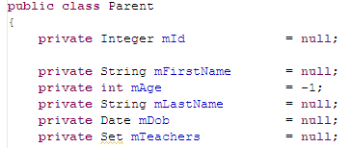
Hibernate: Two Tables using an Association Table only the keys in Association Table
• Now the classes that model those tables.
• In this case—merely because we have only keys in the association table—there is no need to map a class to the association table.

Slide 59
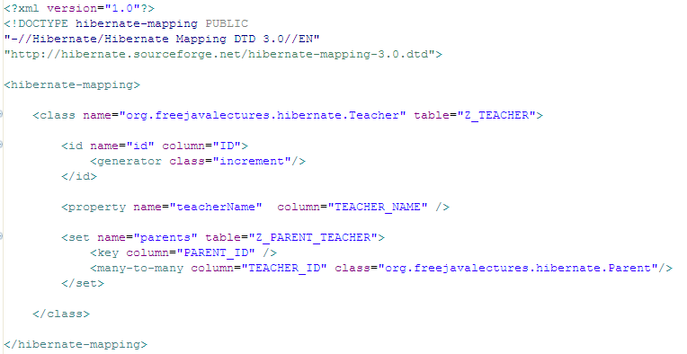
Hibernate: Two Tables using an Association Table only the keys in Association Table
• So, let’s look at the Teacher.hbm.xml mapping
This Set will hold all the parents
This is damned confusing. The <key column is the key to the OTHER end [Parent] of the association.
The <many-to-many column is the key to THIS end [Teacher] of the association.

Slide 60
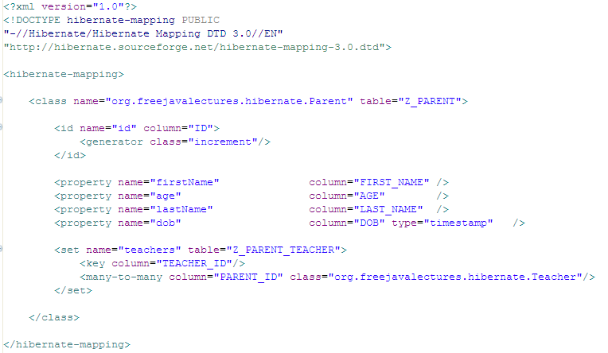
Hibernate: Two Tables using an Association Table only the keys in Association Table
• So, let’s look at the Parent.hbm.xml mapping
This Set will hold all the teachers
The <key column is the key to the OTHER end [Teacher] of the association.
The <many-to-many column is the key to THIS end [Parent] of the association.

Slide 61
Hibernate: Two Tables using an Association Table only the keys in Association Table
• The execution code below shows what is happening.
• First, I create a new Teacher object.
• I use Hibernate to put that new Teacher in the database.
• Then, I create a new Parent object
• I use Hibernate to put that new Parent in the database.

Slide 62
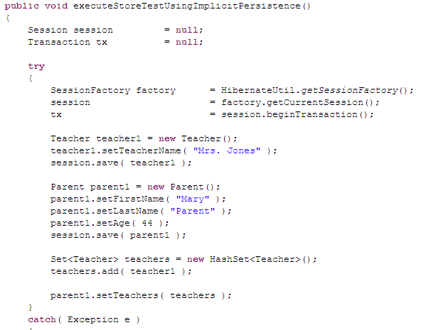
Hibernate: Two Tables using an Association Table only the keys in Association Table
First we save the teacher.
Next, we save the parent
At this point, Hibernate is aware of our teacher and our parent objects.
So, when we modify the parent object—by setting its teachers, Hibernate will react—without us doing another thing—by persisting the association we just defined—when the transaction is committed. It’s really amazing.

Slide 63
Hibernate: Two Tables using an Association Table only the keys in Association Table
First we save the Teacher.
Notice what Hibernate did in response to that? It found the highest ID in Z_TEACHER.
Hibernate:
select
max(ID)
from
Z_TEACHER
Hibernate:
select
max(ID)
from
Z_PARENT
Hibernate:
insert
into
Z_TEACHER
(TEACHER_NAME, ID)
values
(?, ?)
Hibernate:
insert
into
Z_PARENT
(FIRST_NAME, AGE, LAST_NAME, DOB, ID)
values
(?, ?, ?, ?, ?)
Hibernate:
insert
into
Z_PARENT_TEACHER
(TEACHER_ID, PARENT_ID)
values
(?, ?)
Next, we save the Parent.
Notice what Hibernate did in response to that? It found the highest ID in Z_PARENT.
Then Hibernate inserted the Teacher.
Then Hibernate inserted the Parent.
Finally, Hibernate inserted a row in the association table. Pretty amazing stuff, eh?

Slide 64
Hibernate: Review So Far
• That covers Two Tables using an Association table.
• What other complications could we encounter?
→ One Table—already covered.
→ Two Tables linked by a foreign key—already covered.
→ Two Tables using an Association Table only
the keys in Association Table—already covered.
→ Two Tables linked by an Association Table
with extra non-key attributes on the
Association Table.
→ Join on Several Tables.

Slide 65
Hibernate:
Two Two Tables linked by an Association Table with extra non-key attributes on the Association Table

Slide 66
Hibernate: Two Tables using an Association Table with extra non-key attributes on the Association Table
• This one is even more more complex.
• This variant is used to map a M:N relationship.
• We will need an Association table.
→ This association table uses a composite primary key.
→ The Primary Key is both attributes.
→ The Association Table has EXTRA non-key
attributes in the association table.

Slide 67
Hibernate: Two Tables using an Association Table with extra non-key attributes on the Association Table
• So here are the tables we are trying to map, for parent-teacher conferences.
CREATE TABLE Z_PARENT
(
ID INTEGER NOT NULL,
FIRST_NAME VARCHAR2(20 BYTE),
AGE NUMBER,
LAST_NAME VARCHAR2(20 BYTE),
DOB DATE
)
The main difficulty here is the requirement to have extra attributes on the association table.
CREATE TABLE Z_PARENT_TEACHER
(
TEACHER_ID INTEGER NOT NULL,
PARENT_ID INTEGER NOT NULL,
CONFERENCE_ROOM VARCHAR2(50 BYTE),
CONFERENCE_DATE DATE
)
CREATE TABLE Z_TEACHER
(
ID INTEGER NOT NULL,
TEACHER_NAME VARCHAR2(50 BYTE)
)

Slide 68
Hibernate: Two Tables using an Association Table with extra non-key attributes on the Association Table
• Because of the presence of those extra attributes, we are forced to actually create a mapping for the association table.
• But—because I hate fragmentary examples—I am going to repeat 100% of the files needed.

Slide 69
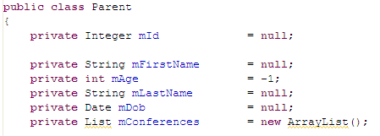
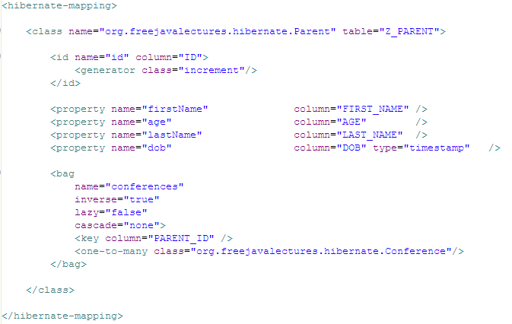
Hibernate: Two Tables using an Association Table with extra non-key attributes on the Association Table
I made this to a List for no reason other than to offer another example.
A List maps to a Hibernate bag
Now the mapping is quite different. Here, we refer only to the class Conference that contains the association. (There are more attributes that we will return to and discuss after the end of the example.)

Slide 70

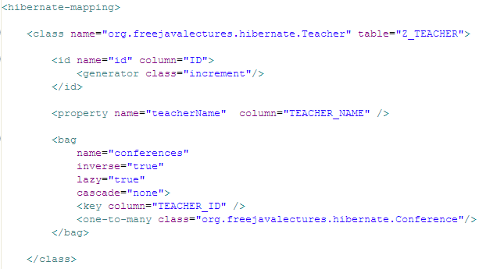
Hibernate: Two Tables using an Association Table with extra non-key attributes on the Association Table
As you can see, the bag portion of this mapping file is almost identical to the version in Parent.

Slide 71
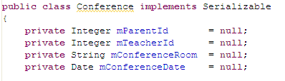

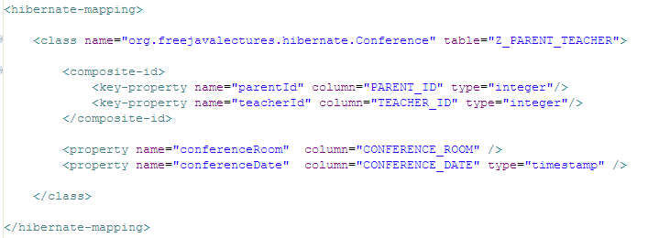
Hibernate: Two Tables using an Association Table with extra non-key attributes on the Association Table
This is a new requirement. The Association-mapping class must implement Serializable.
from hibernate.cfg.xml
This is a new mapping class. Add it to the hibernate.cfg.xml file.
This class also has a composite-primary key. In general, this is how you define the mapping for a composite primary key.

Slide 72
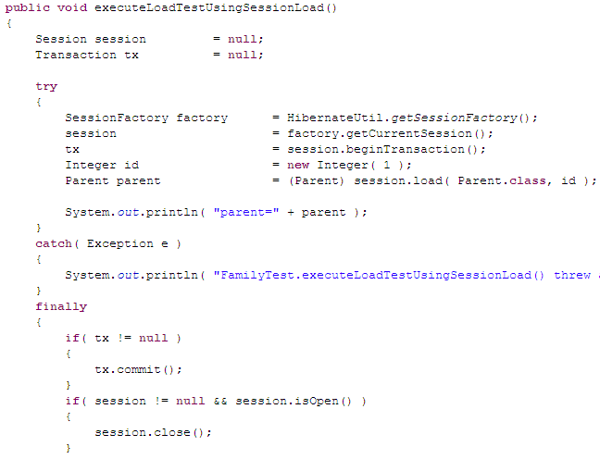
Hibernate: Two Tables using an Association Table with extra non-key attributes on the Association Table
• The execution code is unchanged.

Slide 73
Hibernate: Two Tables using an Association Table with extra non-key attributes on the Association Table
• The SQL that Hibernate generates is as follows:
So, we see that Hibernate first got the matching parents and then it went to the association table and grabbed those. Pretty simple.
Hibernate:
select
parent0_.ID as ID0_,
parent0_.FIRST_NAME as FIRST2_0_,
parent0_.AGE as AGE0_,
parent0_.LAST_NAME as LAST4_0_,
parent0_.DOB as DOB0_
from
Z_PARENT parent0_
where
parent0_.ID=?
Hibernate:
select
conference0_.PARENT_ID as PARENT1_1_,
conference0_.TEACHER_ID as TEACHER2_1_,
conference0_.PARENT_ID as PARENT1_2_0_,
conference0_.TEACHER_ID as TEACHER2_2_0_,
conference0_.CONFERENCE_ROOM as CONFERENCE3_2_0_,
conference0_.CONFERENCE_DATE as CONFERENCE4_2_0_
from
Z_PARENT_TEACHER conference0_
where
conference0_.PARENT_ID=?

Slide 74
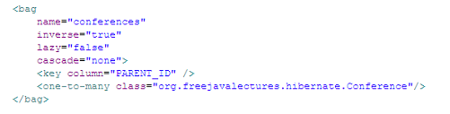
Hibernate: Two Tables using an Association Table with extra non-key attributes on the Association Table
• Recall that this mapping has some new attributes that we need to explain.
name=“conferences”
This just refers to a getter in Parent called getConferences().
from Parent.hbm.xml
inverse=“true”
This is complex so I will defer the explanation to the next “sidebar” slide.
cascade=“none”
This is complex so I will defer the explanation to the next “sidebar” slide.

Slide 75
Mapping ‘inverse’
• When you have two classes involved in a relationship, Hibernate needs to know how to behave in regard to that relationship.
• When you put inverse=“true” in your mapping documents, you are telling Hibernate: “If you’re trying to find out information about this relationship—look from the other side, not this one.”
• So, in shorthand notation:
→ inverse=“true” → means → Look from the other side.
→ inverse=“false” → means → Look from this side.

Slide 76
Mapping ‘inverse’
• So, since we had written inverse=“true” in our example, how does that affect the way we use it?
Hibernate: “I want to explore the relationship between Parent and Teacher. Since the mapping for Parent says: inverse=“true”, I am going to look at:”
List conferences = myTeacher.getConferences();
Hibernate: “If the mapping in Parent said inverse=“false” then I would have looked at:
List conferences = myParent.getConferences();

Slide 77
Mapping ‘inverse’
• So here are the shorthand rules:
All bi-directional associations [where you can reach the association object from either side] need to have at least one side be declared with the inverse= keyword.
In a one-to-many association, the inverse keyword must be on the many side.
→ In a many-to-many association, you can put the inverse keyword on either side. It makes no difference.

Slide 78
Mapping ‘cascade’
• The keyword ‘cascade’ refers to what happens when a parent object has child objects
none – do nothing. Just save the object we’re saving and ignore the children
save-update – when updating the parent, save the children too.
delete – when deleting the parent, its children are automatically saved
all – all actions are cascaded from the parent to the child
all-delete-orphan – all actions are cascaded from the parent to the child and also orphan children are deleted.

Slide 79
Hibernate: Review So Far
• That covers Two Tables using an Association table.
• What other complications could we encounter?
→ One Table—already covered.
→ Two Tables linked by a foreign key—already covered.
→ Two Tables using an Association Table only
the keys in Association Table—already covered.
→ Two Tables linked by an Association Table
with extra non-key attributes on the
Association Table —already covered.
→ Join on Several Tables.

Slide 80
Hibernate:
Join On Several Tables

Slide 81
Hibernate: Join On Several Tables
• In this example, I have two tables that I need to do a simple join on.
• In Hibernate, there seems to be a hundred ways to do the same thing. This is a simple example that gets the job done.

Slide 82
Hibernate: Join On Several Tables
• Here are the original TITLE and MERCHANDISE tables.
CREATE TABLE TITLE
(
TITLE_SEQ NUMBER NOT NULL,
LONG_TITLE VARCHAR2(50 BYTE)
);
CREATE UNIQUE INDEX TITLE_SEQ_PK ON TITLE
(
TITLE_SEQ
);
ALTER TABLE TITLE ADD
(
CONSTRAINT TITLE_SEQ_PK
PRIMARY KEY (TITLE_SEQ)
);
CREATE TABLE MERCHANDISE
(
EAN CHAR(13 BYTE) NOT NULL,
TITLE_SEQ NUMBER,
);
ALTER TABLE MERCHANDISE ADD
(
CONSTRAINT PK_MERCHANDISE
PRIMARY KEY (EAN)
);

Slide 83
Hibernate: Join On Several Tables
• Our intention is to perform this query against these tables.
SELECT
T.LONG_TITLE
FROM
TITLE T,
MERCHANDISE M
WHERE
T.TITLE_SEQ = M.TITLE_SEQ
AND
M.EAN = :ean
CREATE TABLE TITLE
(
TITLE_SEQ NUMBER NOT NULL,
LONG_TITLE VARCHAR2(50 BYTE)
);
CREATE UNIQUE INDEX TITLE_SEQ_PK ON TITLE
(
TITLE_SEQ
);
ALTER TABLE TITLE ADD
(
CONSTRAINT TITLE_SEQ_PK
PRIMARY KEY (TITLE_SEQ)
);
CREATE TABLE MERCHANDISE
(
EAN CHAR(13 BYTE) NOT NULL,
TITLE_SEQ NUMBER,
);
ALTER TABLE MERCHANDISE ADD
(
CONSTRAINT PK_MERCHANDISE
PRIMARY KEY (EAN)
);

Slide 84
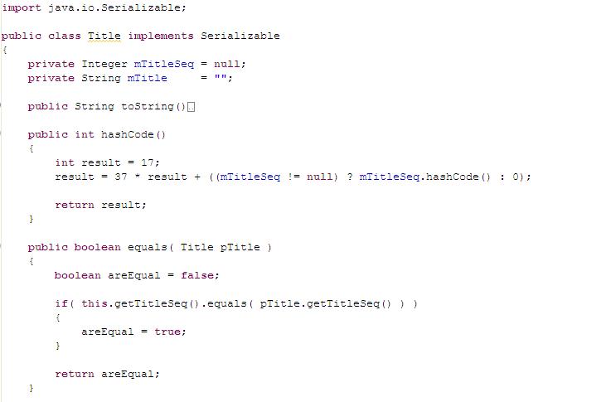
Hibernate: Join On Several Tables
• So, how do we do that in Hibernate?
• Well, our first step is to map both of the tables with Hibernate classes and mapping files.
This is just a plain ordinary Java class.
It implements Serializable
It correctly has the required hashCode() and equals() methods.
The setters and getters are omitted here.

Slide 85

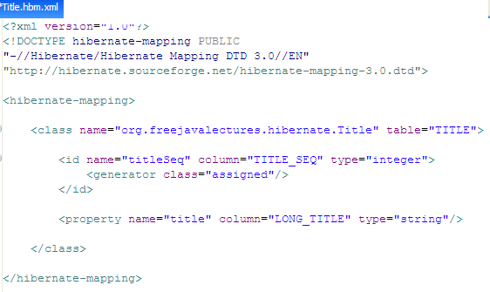
Hibernate: Join On Several Tables
• So, how do we do that in Hibernate?
• Well, our first step is to map both of the tables with Hibernate classes and mapping files.
Also, in this case, we are using a primary key that is “assigned”—which means that Hibernate should let us set the value for the object’s primary key.
Notice that our Java Integer type maps to the Hibernate type “integer”.
The String Java type will map to a Hibernate “string” type.

Slide 86
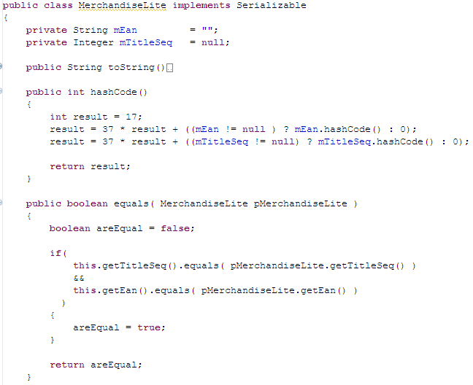
Hibernate: Join On Several Tables
This is just a plain ordinary Java class.
It implements Serializable
It correctly has the required hashCode() and equals() methods.
The setters and getters are omitted here.
• Next, the Merchandise table

Slide 87

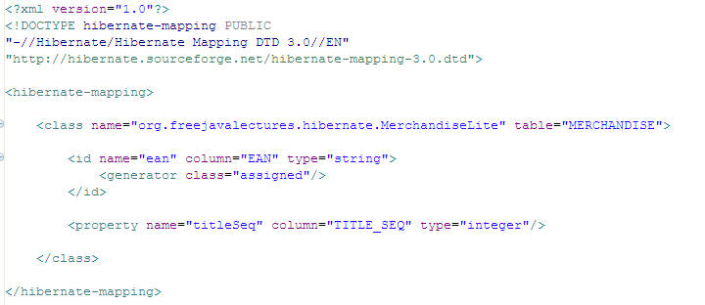
Hibernate: Join On Several Tables
• The same issues apply here as did in the TITLE table.

Slide 88
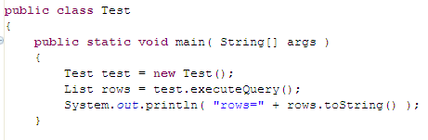
Hibernate: Join On Several Tables
• Now that we have the mappings setup, let’s see how we execute this.
This just starts things.

Slide 89
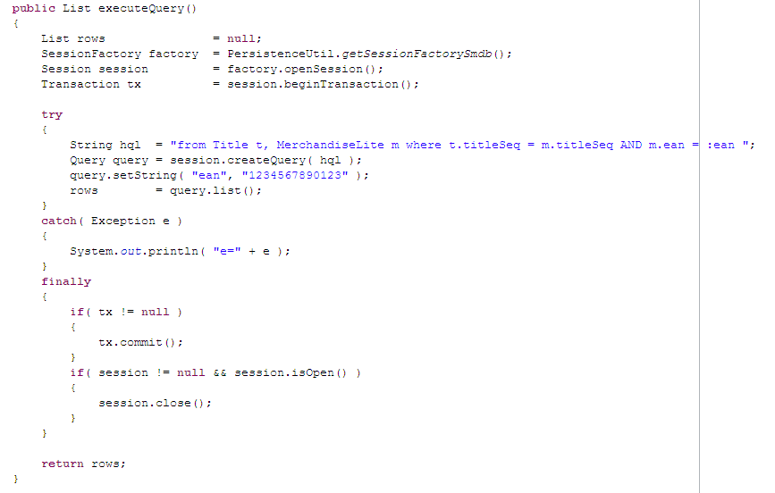
Hibernate: Join On Several Tables
Look at the HQL [Hibernate Query Language]. We see that I’m asking it to give me a Title object and a MerchandiseLite object where the query circumstance is satisfied.
Notice that I’m using the method session.createQuery(). If I had chosen instead to use session.createSQLQuery(), then I could have given it the original SQL Query at the start of this section. [But that’s no fun—that approach doesn’t need Hibernate!]

Slide 90
Hibernate: Join On Several Tables
• Now what would the List rows actually contain?
• Well, we asked Hibernate to give us TWO objects [Title and MerchandiseLite]
• So, the rows will contain this:
public static void main( String[] args )
{
Test test = new Test();
List rows = test.executeQuery();
Object[] objs = (Object[]) rows.get( 0 );
Title tit = (Title) objs[ 0 ];
MerchandiseLite merch = (MerchandiseLite) objs[ 1 ];
}
• There are alternative ways that are smarter.
• I will include as many varied examples as I can.

Slide 91
Hibernate:
Complete Example

Slide 92
Hibernate: Complete Example
• Often we one is reading these lectures, you wish that you could see the actual process from beginning to end.
• I agree. So, I’m going to create a Hibernate project in Eclipse and then I will do everything it takes to get a working example—including setting up my workspace.

Slide 93
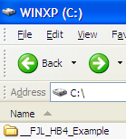
Hibernate: Complete Example
• First, we need to create an Eclipse workspace.
• So, I will first create a blank directory.
As you see here, I have just created a plain directory on my file system. The name is not important.
Right now it is empty.

Slide 94
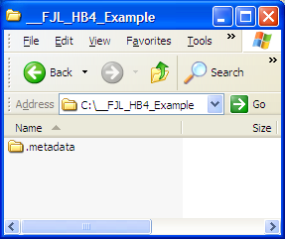
Hibernate: Complete Example
• Using Eclipse, (with MyEclipse!) I open up the just-created workspace.
After I open up an Eclipse workspace, Eclipse inserts this .metadata directory inside my workspace.

Slide 95

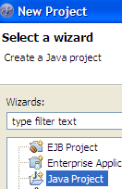
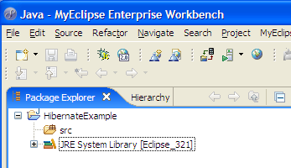
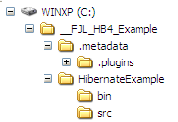
Hibernate: Complete Example
• I create a new Java Project in Eclipse [steps 1,2,3]. Let’s see what that added to the directory we were just looking at.
1
2
3
The creation of the above “Project” has added a directory called “HibernateExample” and its src and bin directories.

Slide 96
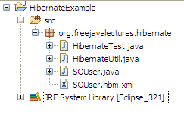
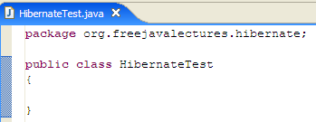
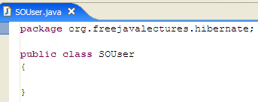
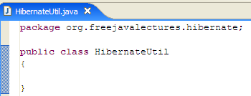

Hibernate: Complete Example
• Next, I want to create two Java classes and one xml file.
Obviously, these all start off with nothing.

Slide 97
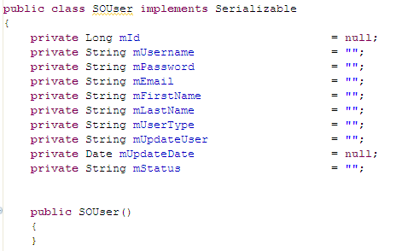
Hibernate: Complete Example
• First, let’s create the model object that will contain our data. This will also require a DB table.
As you can see here, we have several attributes that we want to save. These will need a table to hold them and so, below, we see the table.,
CREATE TABLE SO_USER
(
ID INTEGER,
USERNAME VARCHAR2(50 BYTE) NOT NULL,
PASSWORD VARCHAR2(50 BYTE) NOT NULL,
FIRST_NAME VARCHAR2(50 BYTE),
LAST_NAME VARCHAR2(50 BYTE),
EMAIL VARCHAR2(100 BYTE),
USER_TYPE VARCHAR2(20 BYTE),
UPDATE_USER VARCHAR2(50 BYTE),
UPDATE_DATE DATE DEFAULT SYSDATE,
STATUS VARCHAR2(10 BYTE)
)

Slide 98
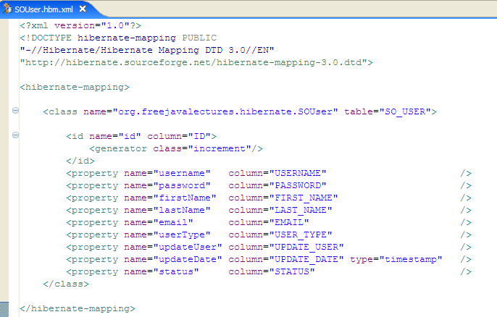
Hibernate: Complete Example
• This is the mapping file that goes with the SOUser.java class from the previous slide.

Slide 99
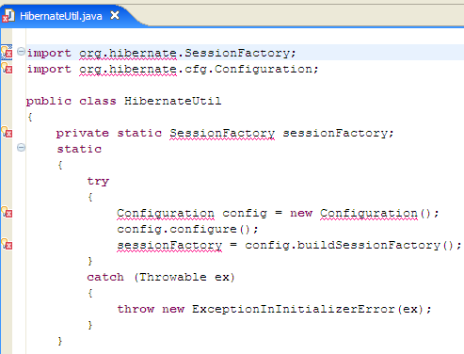
Hibernate: Complete Example
• Finally, we will create the code to test what we have.
• The code below will just get us our Hibernate SessionFactory object.
When I add our first Hibernate-specific code, we see that the imports are not found. So, we need to import some JAR files.

Slide 100

Hibernate: Complete Example
• As you can see, Hibernate uses a lot of 3rd-party Jar files.
• With every release of Hibernate, these will change and so you—as a Hibernate developer—must keep track of which versions are correct.
• I am now going to insert these Jar files into my project.

Slide 101

Hibernate: Complete Example
• Notice that I placed the Jar files into the root of the HibernateExample project directory. When you’re using Eclipse, it’s important that you let Eclipse know about the Jar files so Eclipse can set the .classpath values accordingly.

Slide 102


Hibernate: Complete Example
Before I refresh this directory, this is what it contains—no Jar files.
After I refresh this directory, the HibernateExample directory shows all the Jar files—but!—they are not yet part of the project.

Slide 103




Hibernate: Complete Example—Setting up Jars
1
Right-mouse click on the project and choose properties.
After I clicked on Properties, I selected Java Build Path and the Libraries tab. Then, I click on “Add JARs”.
3
4
5
Then, after I click on Add Jars, I see all the Jars I just added are available. I select them all and we see that the jar files (below) are now officially incorporated into the project.
2
6
7
Make sure this includes your DB Drivers!

Slide 104

Hibernate: Complete Example
• As you can also see, importing the Jars has resolved all the problems with missing classes. (No red X’s)

Slide 105

Hibernate: Complete Example
• Finally, since we have built all the infrastructure, we now write the class that actually performs the test.
First, notice that I have created an instance of the SOUser class and then set several instance variables.
Notice that I do not set the id field. Why not? Because only Hibernate can set that identifier field.

Slide 106

Hibernate: Complete Example
• Looking a little further down in this class, we see the simple Hibernate execution sequence.
We use our HibernateUtil class to get the session factory. From that we get a Hibernate Session object and begin a transaction.
Finally, we ask Hibernate to save our object. It is entirely up to Hibernate to do this for us. Hibernate has a lot of these types of “save()” methods that do common type tasks. We will be learning a lot about them in the following slides.

Slide 107

Hibernate: Complete Example
• Attempting to run this class throws an exception.
• This happened because we forgot to include the Hibernate configuration file.

Slide 108

Hibernate: Complete Example
• The required config file has two variants. It should be placed at the root of the src directory.

Slide 109

Hibernate: Complete Example: Config file
The driver class
The Hibernate version or “dialect” that should be used—in this case that means the Oracle dialect.

Slide 110

Hibernate: Complete Example: Config file
This is the all-important DB connection URL. myserver = the host name where your db is located. The value mysid is just the name of your database.The driver is repeated again and then the username and password that are used to make a DB connection are also needed.
Also, notice that we must register our SOUser.hbm.xml file here. Otherwise, Hibernate will not know it exists. Every one of your Hibernated classes must be mentioned here.

Slide 111

Hibernate: Complete Example: Console Output
• This is the actual console output from successfully running the test. Notice that—because we asked Hibernate to spit the SQL it generates into the log—that we see it generated an insert statement.
Finally, we see what was inserted—correctly—into the database.

Slide 112
Hibernate:
One Application—Multiple Databases

Slide 113

Hibernate: One Application—Multiple Databases
• Many times when you are writing an application, it needs to get data from two or more databases. If you’re using Hibernate—your database connection is defined in the single hibernate.cfg.xml file.
• If you recall, this file only allows you to define one database connection.
This line tells us the name of the host server and the database SID to which we want to connect.

Slide 114



Hibernate: One Application—Multiple Databases
• Look at the following scrap of code. This is where the hibernate.cfg.xml file is read.
Because the line configure() does not point to a specific configuration file, Hibernate looks for it at the root of the bin directory.
At deploy time, this file is moved from the root of the src directory to the root of the bin directory, where Hibernate will be looking for it.

Slide 115
Hibernate: One Application—Multiple Databases
• Now, if we wish to point to TWO hibernate.cfg.xml files (one will point to databaseA, another will point to databaseB) then we need to pass in two different named files

Slide 116


Hibernate: One Application—Multiple Databases
• As you can see here, we need to create two SessionFactory objects—one devoted to each database connection.
Okay then, where do I place my file so that it gets picked up? Answer: you place them in the exact same place that you placed the original hibernate.cfg.xml. But make sure to include just the String argument to this method and make sure to precede it with a slash!

Slide 117
Hibernate: One Application—Multiple Databases
• Then, in your code, you just get the Session that points to the right database!

Slide 118
Hibernate:
Using a DataSource

Slide 119
Hibernate: Using A DataSource
• As you should know, it’s always better to delegate getting a database connection to the application-server-provided DataSource.
• How do I code that in Hibernate?
• First of all, our attention will only be directed to the hibernate.cfg.xml (or hibernate.properties) file.

Slide 120

Hibernate: Using A DataSource
• Here we will compare the two ways. It’s easy.
Without a DataSource
With a DataSource

Slide 121
Hibernate:
Mapping Agonies

Slide 122
Hibernate: Mapping Agonies
• After you’ve got some experience with Hibernate, you will find your problems revolve around setting up the Hibernate mappings correctly. From here on out we will explore those various mappings.

Slide 123
Hibernate: Mapping Agonies
• Mapping ‘inverse’
• So, in summary:
→ Always provide parent.addChild() with code that updates both sides of the relationship. (In addition to adding the child, also set the parent in each child).
→Always set inverse to true on bidirectional one-to-many.
→ Make sure you understand the difference between cascades and inverse.

Slide 124
Hibernate: Mapping Agonies
• Mapping ‘cascade’
• The keyword ‘cascade’ refers to what happens when a parent object has child objects
none – do nothing. Just save the object we’re saving and ignore the children
save-update – when updating the parent, save the children too.
delete – when deleting the parent, its children are automatically saved
all – all actions are cascaded from the parent to the child
all-delete-orphan – all actions are cascaded from the parent to the child and also orphan children are deleted.

Slide 125
Continued in Advanced Hibernate

